Slide 1
JAVABALL
Presented by
Md. Tanvir Alam
CSE - 2112 – Lab project

Slide 2
Outline
Introduction
Project outline
User end
The game
Special features of the game
Search with automatic ranking
Server end
Helpline chatbot with automatic reply
Areas of further improvement
Statistics and information
Conclusion

Slide 3
Introduction
Implementation of 3d football game to Understand the practical use of object oriented programming
Making a step towards creating animations, software etc.
Working with graphics and to develop ideas
Building algorithms to solve problems

Slide 4
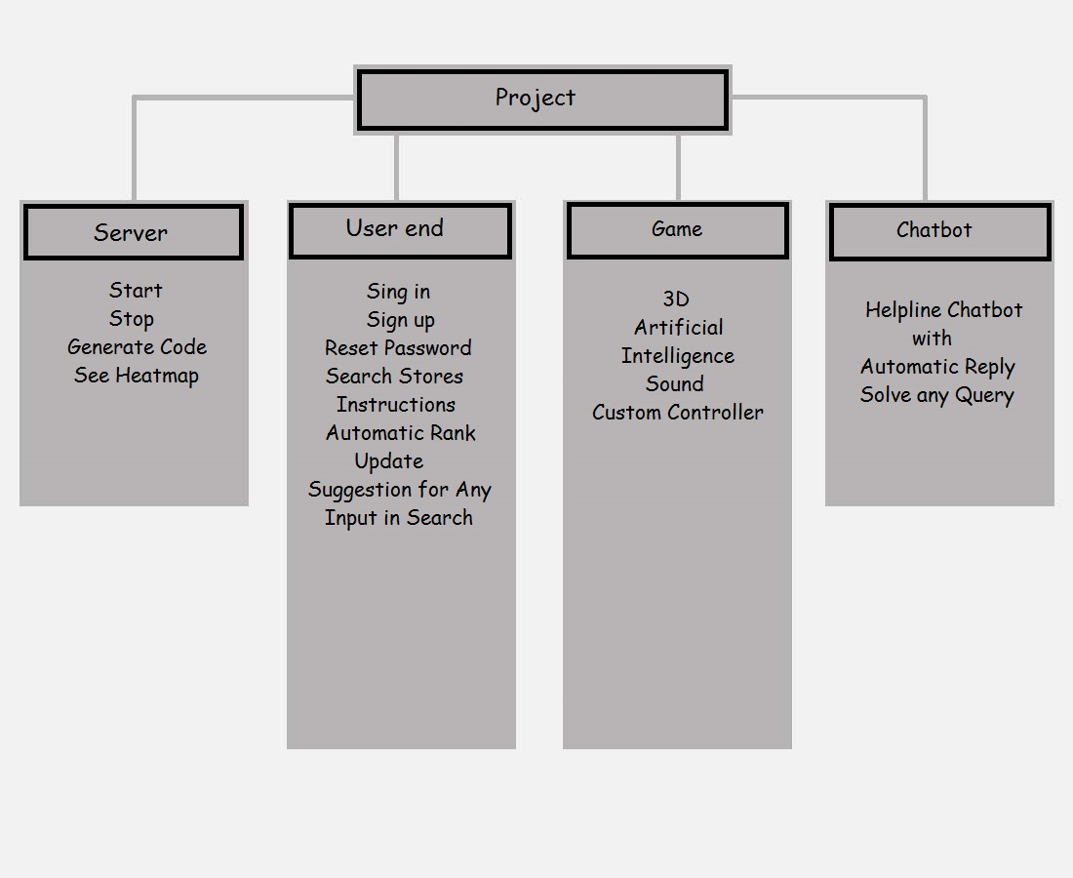
Project outline

Slide 5
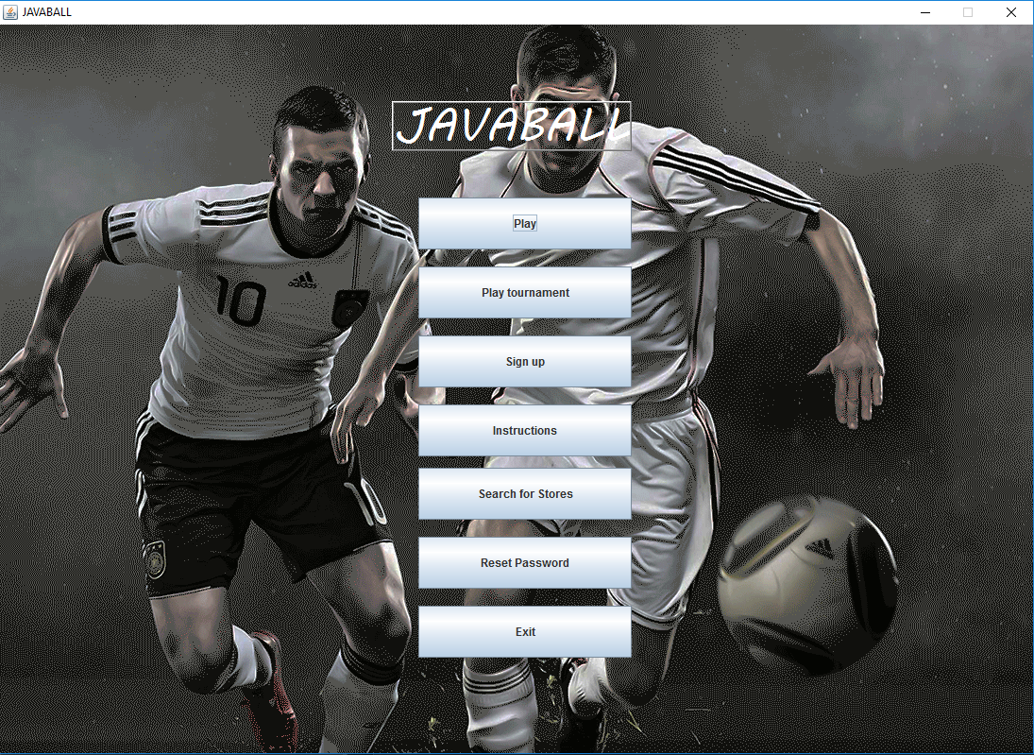
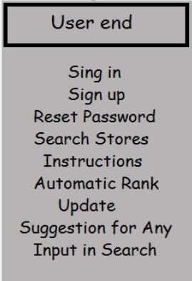
User end

Slide 6
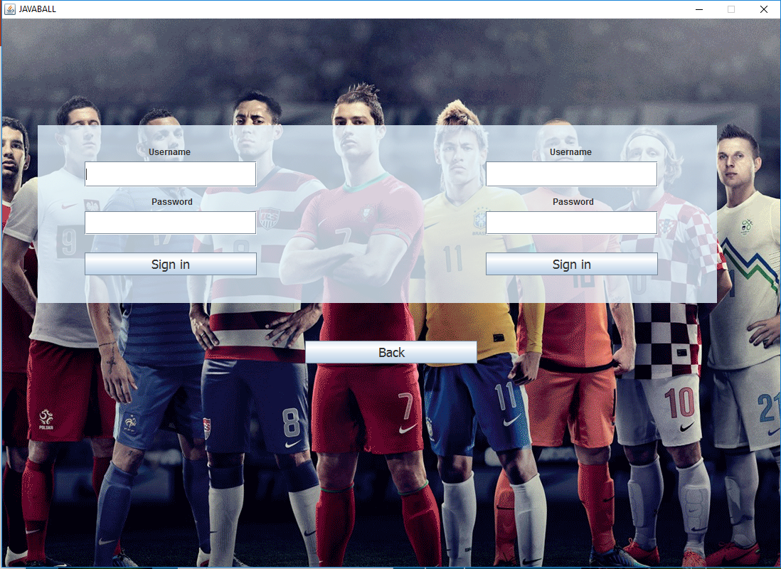
User end
Here two user can Sign in to play

Slide 7
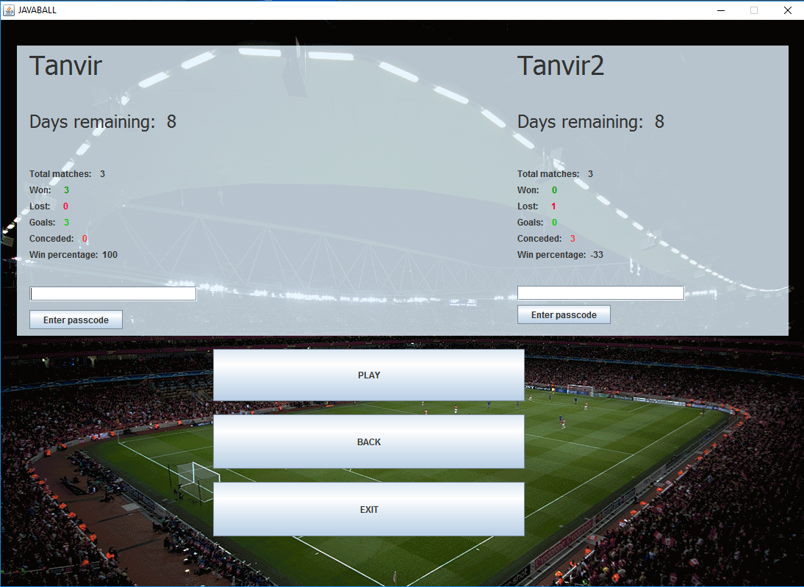
User end
After Signing in, users will be able to see their statistics and play

Slide 8
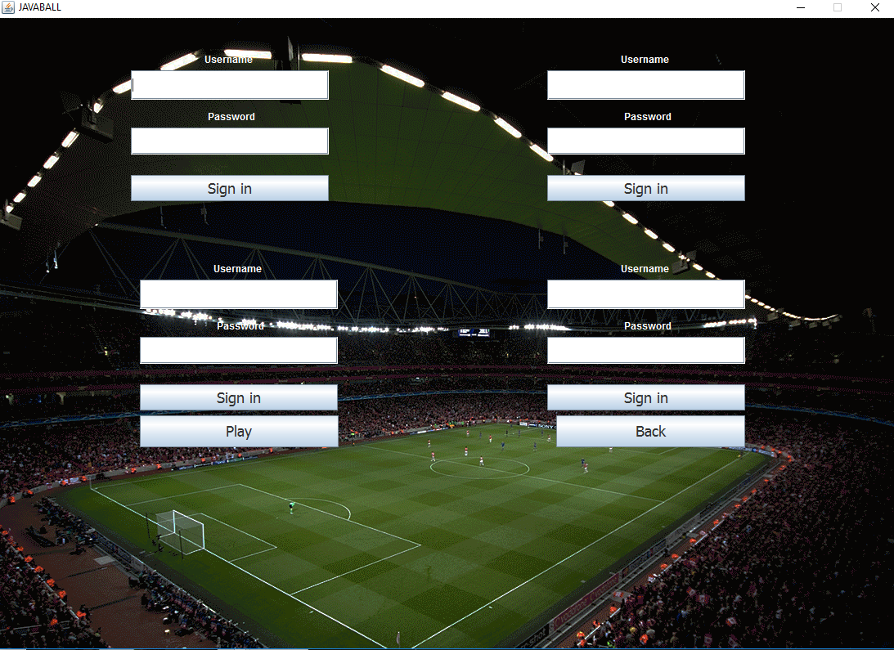
User end
Here four users can sign up and play a tournament

Slide 9
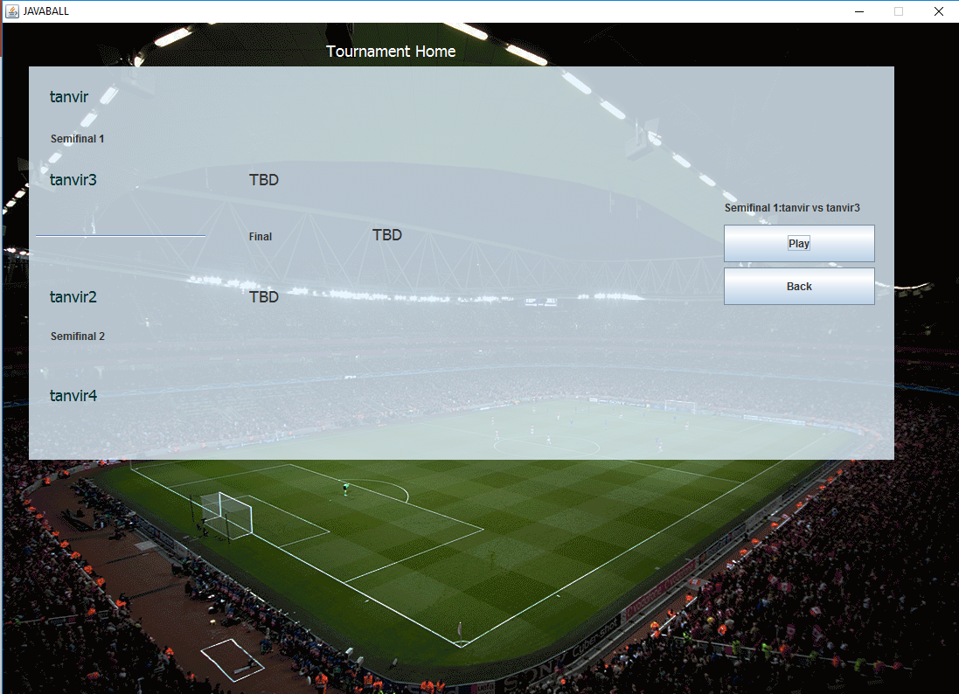
User end
The tournament homepage

Slide 10
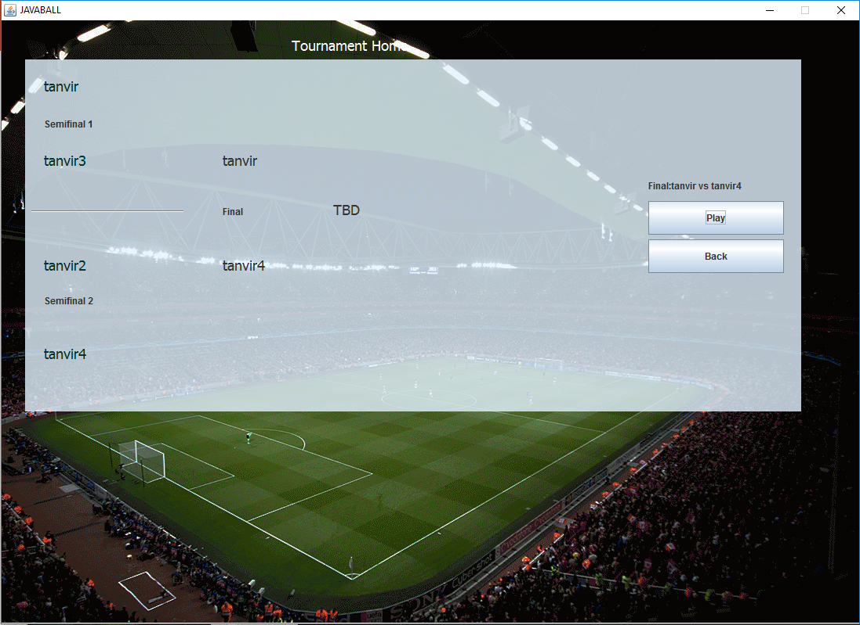
User end
Tournament homepage in an intermediate step

Slide 11
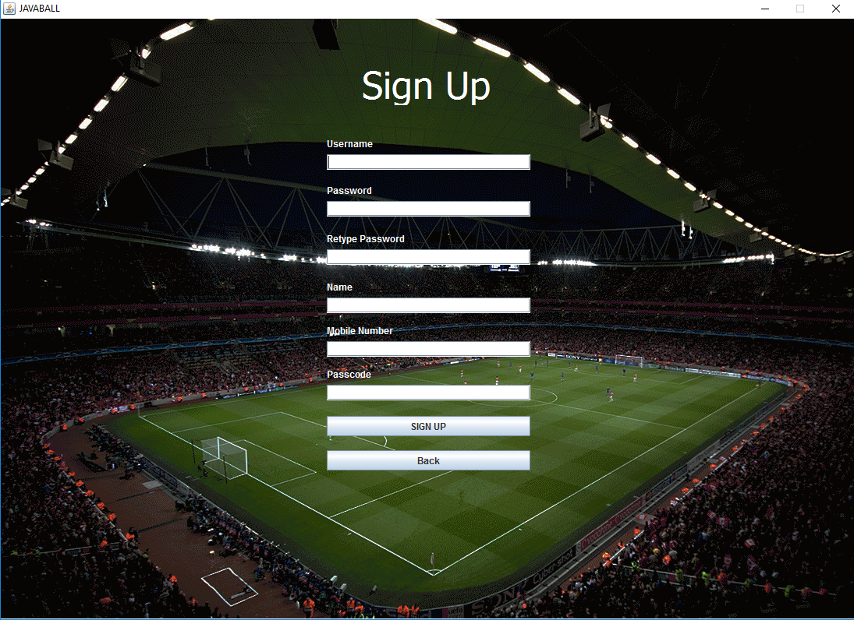
User end
The game is not free
Users will need access codes from server
Codes will be updated automatically to server.
So, user have to be connected to server to play.
The signup page

Slide 12
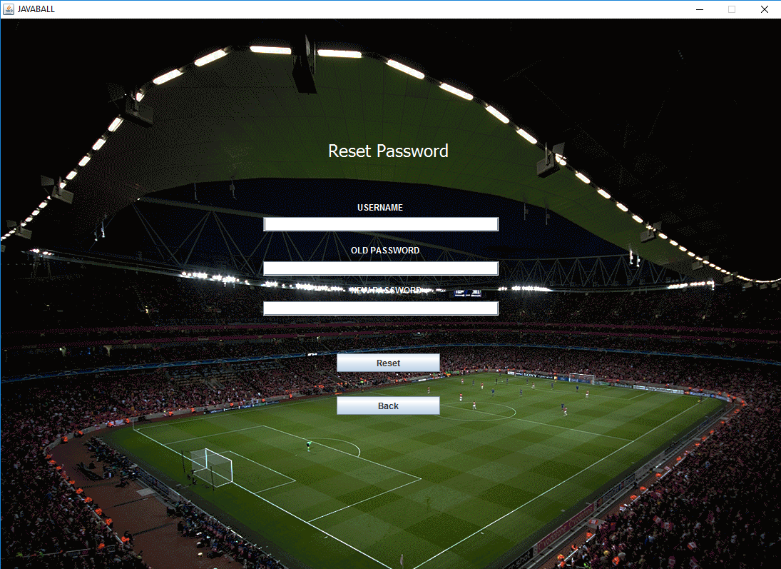
User end
Reset password page

Slide 13
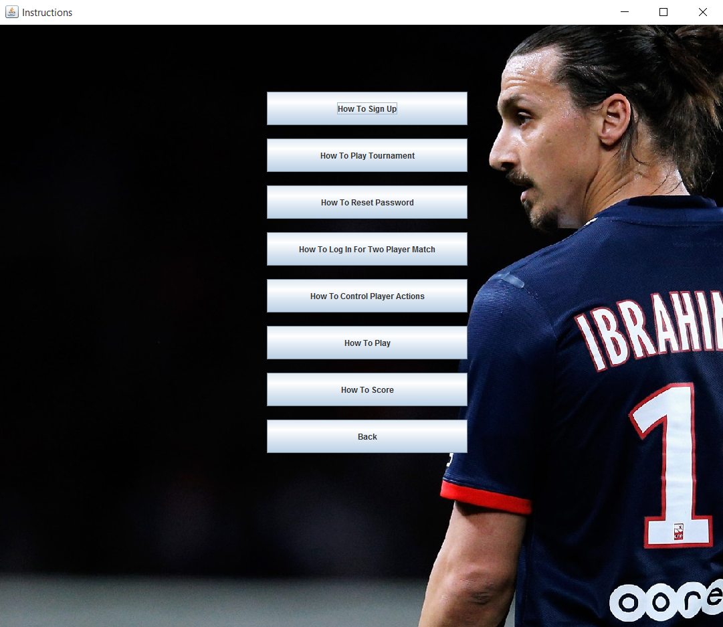
User end
Instructions homepage

Slide 14
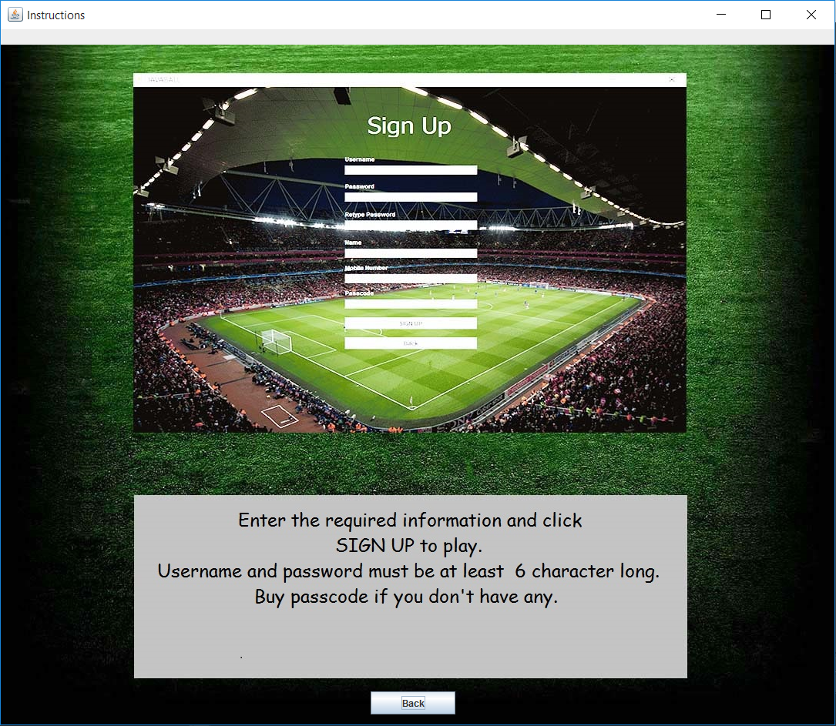
User end
An instructions page

Slide 15
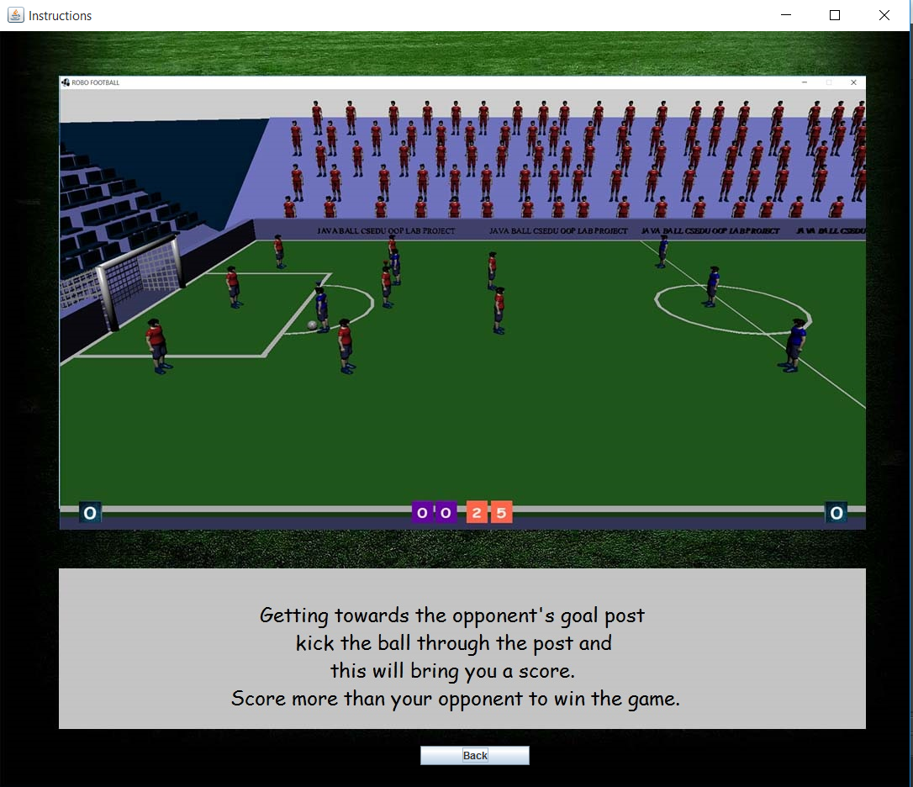
User end
An instructions page

Slide 16
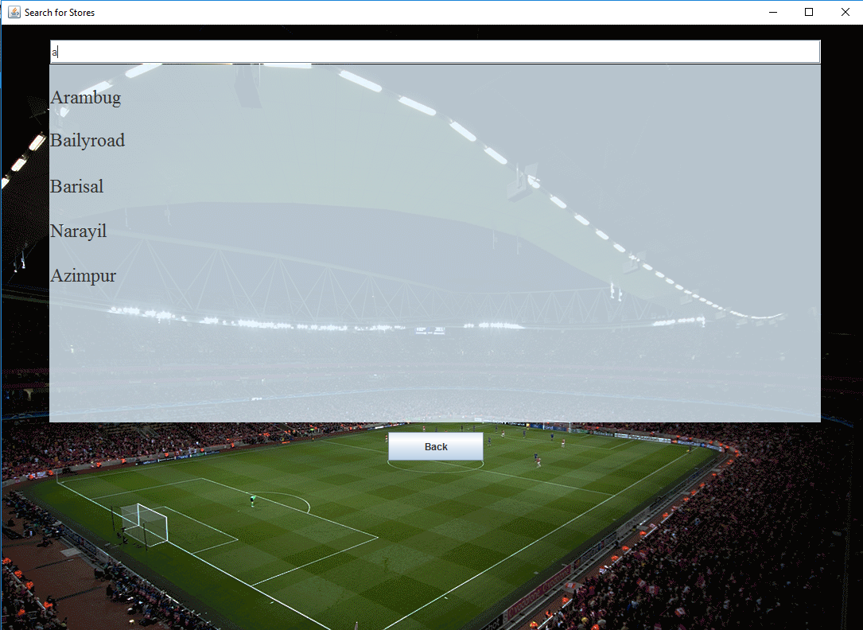
User end
Search for stores

Slide 17
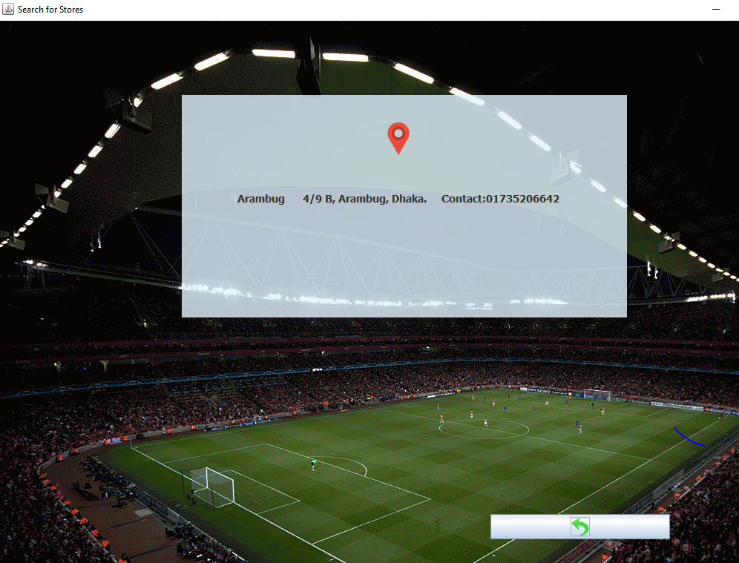
User end
Store details

Slide 18
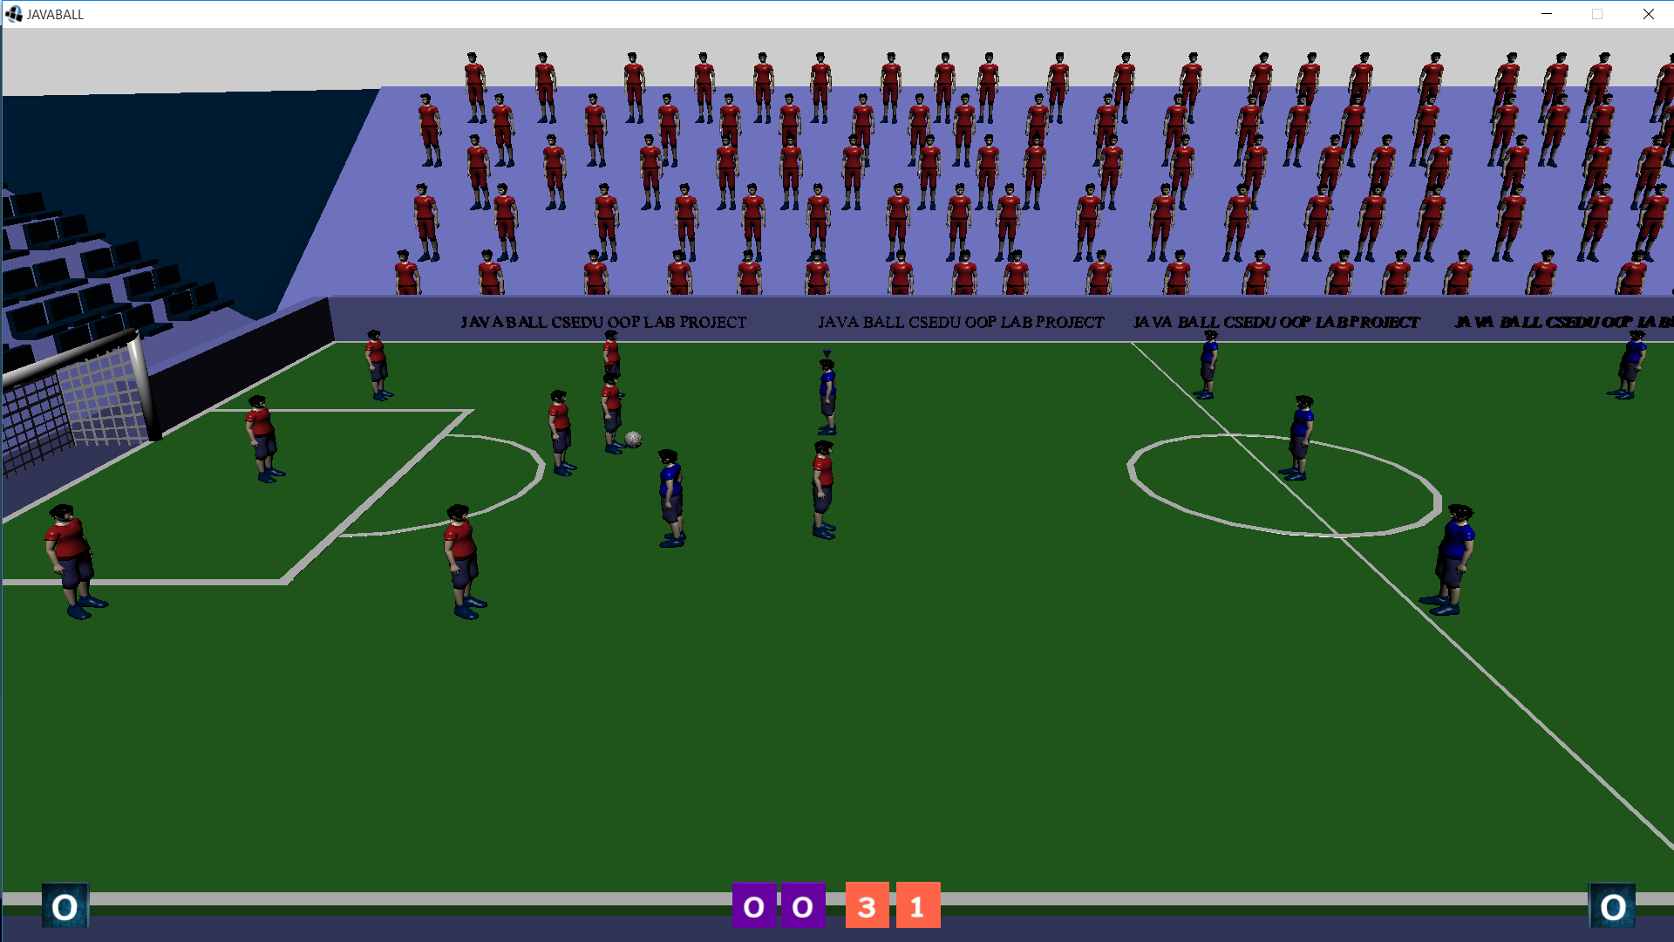
The Game
The game screen

Slide 19
The Game
A football game
Two minutes per match
Eight players in each team
objective is to scores goals by kicking the ball into the post
Most goals determines the winner
Players can pass or lick when they are on possession
Otherwise they have to run towards the ball and grab it back by tackling
The game screen

Slide 20
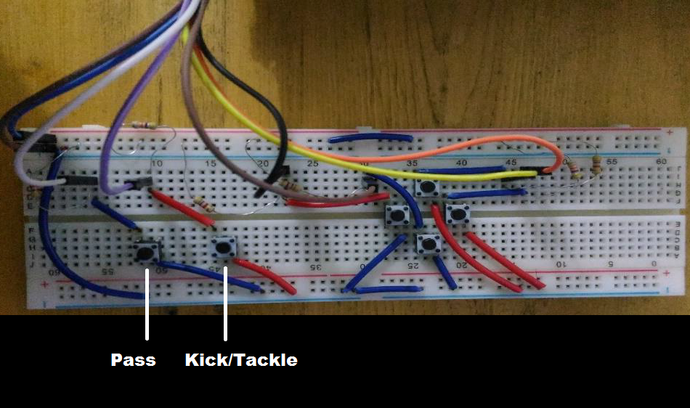
The game
Controls:
The keyboard controls are:
S - pass
D - kick / tackle
Arrow keys- Run
The controller controls are shown in the image

Slide 21
Special features of the game
3d Models: The whole game is displayed using 3d graphics. Each character and game setup is a 3d object modelled and textured by us.
Artificial Intelligence: The users only control the player who is nearest to the ball. Other player plays automatically.
Interactive 3d Audio: While playing the game, sound of crowd will be played. There are many interactive sounds as when any team scores we can hear the sound of the commentator screaming “goal”.
Player animations: All the player’s animation is implemented by coding.
Reduce CPU usage: We limited the quality of rendering the 3D objects with distance. The spectators in the gallery are rendered as low poly objects.
No glitches: in many 3D games it is seen to characters running through other objects as shown below. But in our game, it will never happen.

Slide 22
Search with automatic ranking
An option to search for stores.
Initially, suggestions will be given based on the Euclidian distance of the character frequency vectors of the key user searched for and the results stored.
As our data set will get bigger the user will get more relevant result and the ranking will be updated automatically.
Our search can predict the correct result even when the user makes typing mistake.

Slide 23
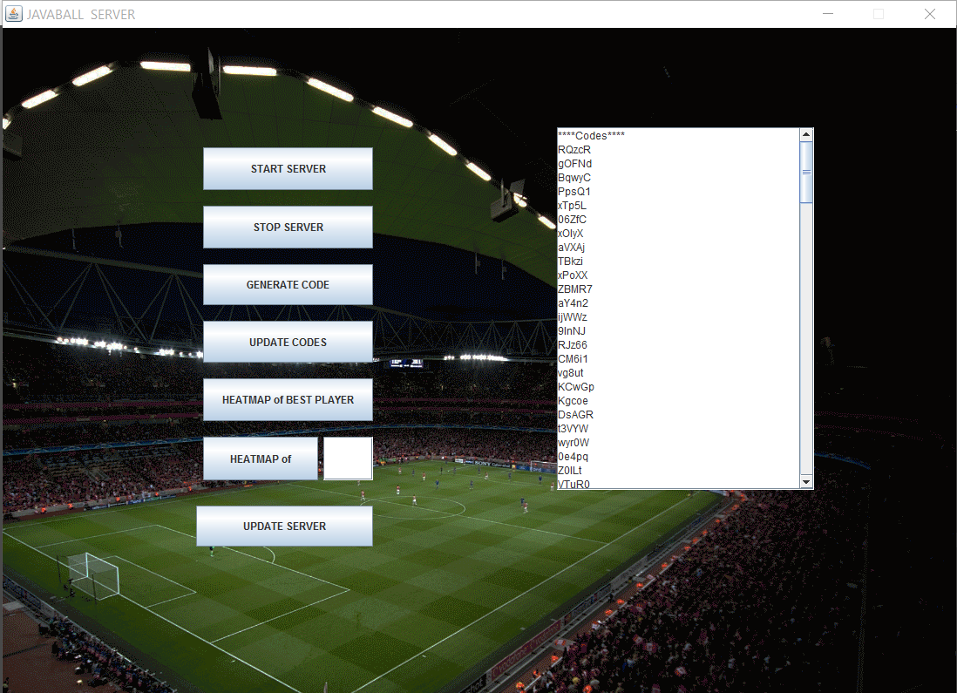
Server end outline
Options:
Start the server
Stop the server
Generate new access code
See heatmaps of players
Server end Homepage

Slide 24
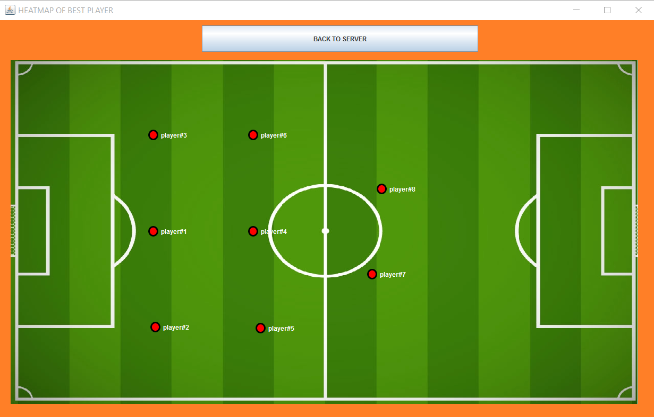
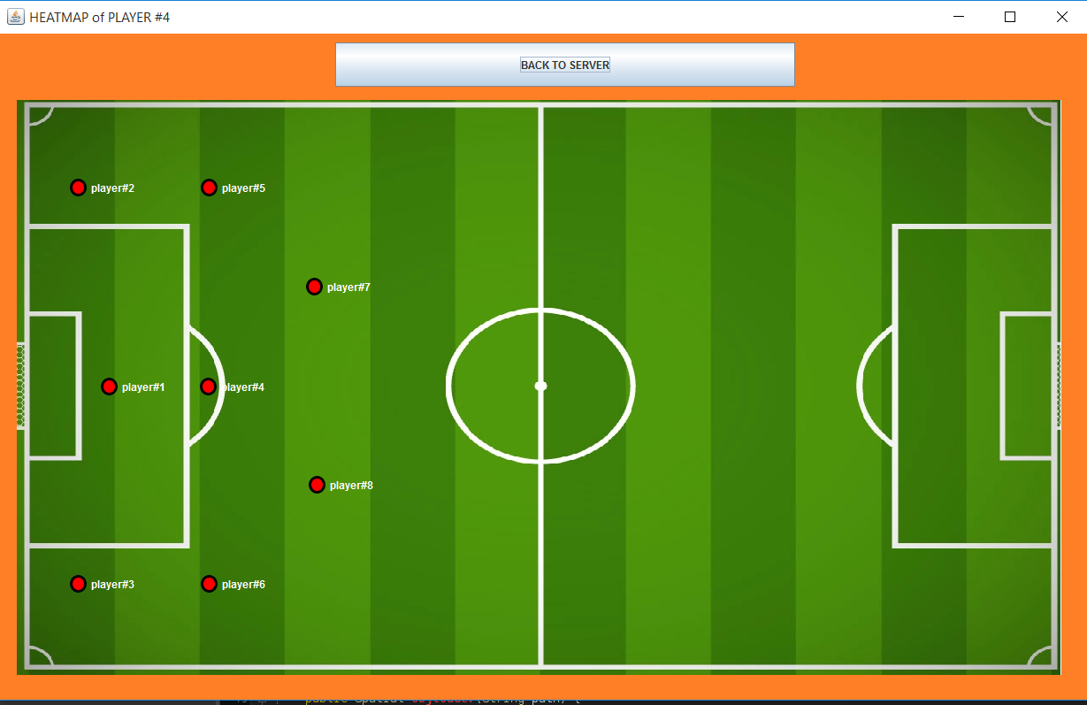
Server end
Heatmap 1
Heatmap 2
Here we can see the player of the left image played more offensive than the right one

Slide 25
Helpline chatbot with automatic reply
In most cases, the solution will be automatically generated.
But if system fails to solve, it will notify the admin to answer the question.
It will automatically learn to answer when admin will answer.
Some automatic replies from the server

Slide 26
Areas of further improvement
Improving the artificial Intelligence:
Network Based Multiplayer:

Slide 27
Statistics and information
CPU Requirements:
Intel Core i3-3225 @ 3.30GHz
NVIDIA GeForce GTX 660 2GB / AMD Radeon HD 7850 2GB
RAM 8GB
OS Windows 7 64bit,DX 11
Total size of project: 845MB
Number of lines of codes:
3D display statistics

Slide 28
Conclusion
The project was helpful for us to completely understand the usefulness of object oriented programming.
Our observation is object oriented programming represent real world better than structured programming.

Slide 29
THANK YOU

Slide 30
Questions

